Slide 1
CLR PARSER USING TKINTER
ROOPAL SOOD (RA2011026010103)
SAYAK DAS (RA2011026010101)

Slide 2
ABSTRACT
The Syntax Analysis project involved implementing a CLR parser for a compiler design course. The project was aimed at constructing a parser for a simple programming language that could recognize and parse input programs into a valid parse tree. The parser was implemented using the CLR parsing algorithm, which is a bottom-up parsing technique. The project involved creating a grammar for the language, constructing the parsing table, and implementing the parsing algorithm. The resulting parser was able to successfully parse a variety of sample programs and was evaluated based on its accuracy and efficiency. Overall, the project provided valuable experience in implementing a fundamental component of a compiler and applying parsing algorithms in a real-world context.

Slide 3
INTRODUCTION
Compiler design is an important aspect of computer science that deals with the development of programs that can translate high-level programming languages into machine code. The process of compilation involves several stages, one of which is syntax analysis. Syntax analysis, also known as parsing, is the process of analyzing the syntax or structure of a program written in a programming language. A CLR parser is a program that performs this task by taking the source code as input and generating first and follow, CLR items and CLR table as output.

Slide 4
OBJECTIVES:
The main objective of the syntax analysis project using CLR parser for compiler design is to implement a bottom-up parsing algorithm that can analyze the syntactic structure of a given input program and generate a parse tree if the program is syntactically correct. The project aims to achieve the following objectives:
To understand the concepts of formal grammars, parsing, and the different types of parsers used in compiler design.
To learn about the CLR parsing algorithm and how it can be implemented to construct a parse tree for a given input program.
To develop a CLR parser that can handle a wide range of context-free grammars and generate an error message if the input program is syntactically incorrect.
To test the CLR parser on a set of sample input programs and analyze its performance in terms of accuracy and efficiency.
To compare the performance of the CLR parser with other parsing algorithms and evaluate its suitability for use in practical compiler design projects.

Slide 5
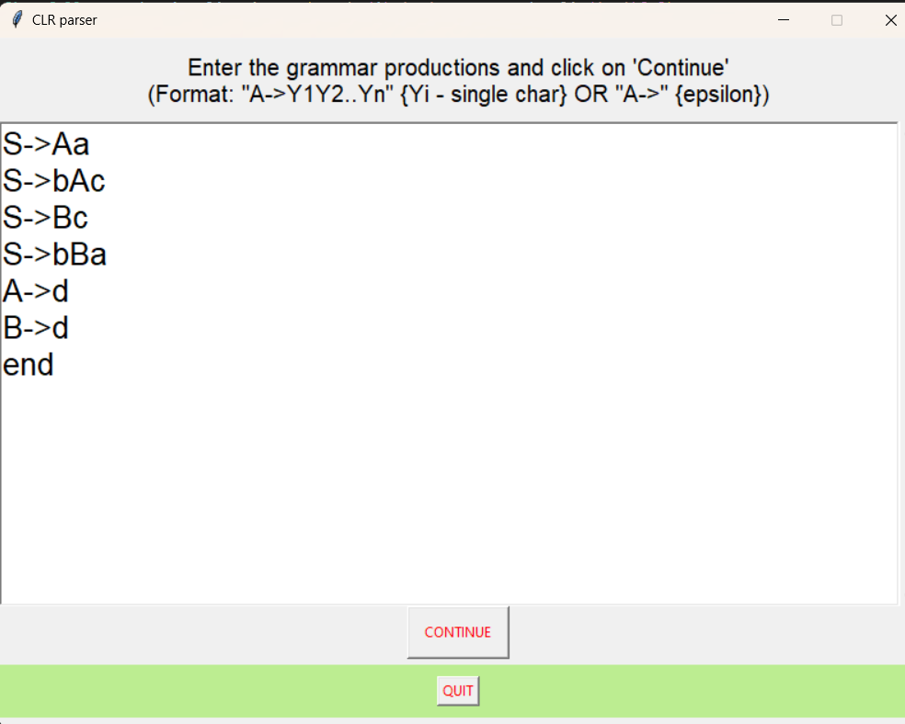
MODULE DESCRIPTION:
Augmented grammar :
If P is a grammar with starting symbol S,then G’ (augmented grammar for G) is a grammar with a new starting symbol S‘ and productions S-> .S‘ . The purpose of this new starting production is to indicate the parser when it should stop parsing. The ‘ . ‘ before S indicates the left side of ‘ . ‘ has been read by a compiler and the right side of ‘ . ‘ is yet to be read by a compiler.

Slide 6
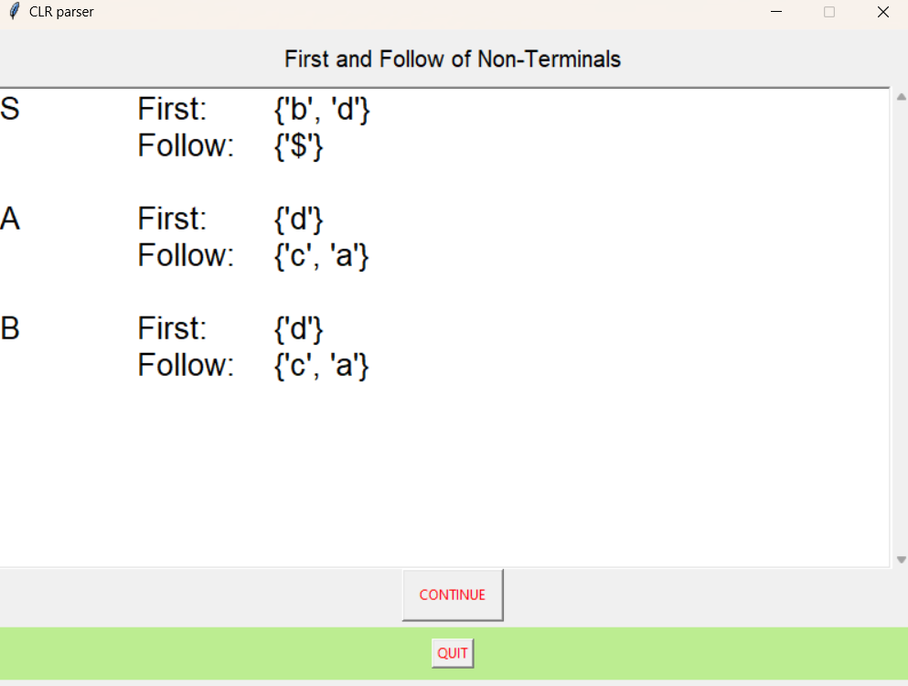
First and Follow:

Slide 7
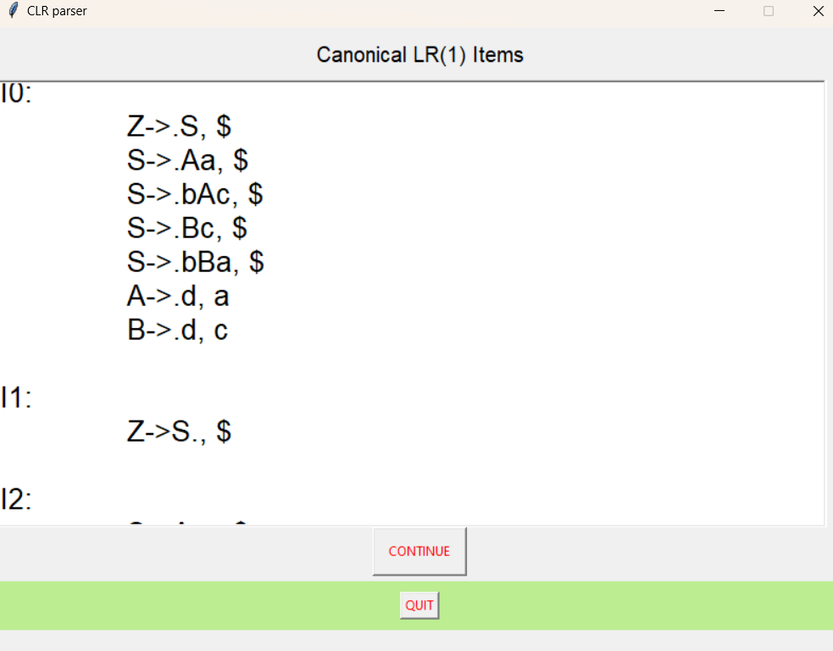
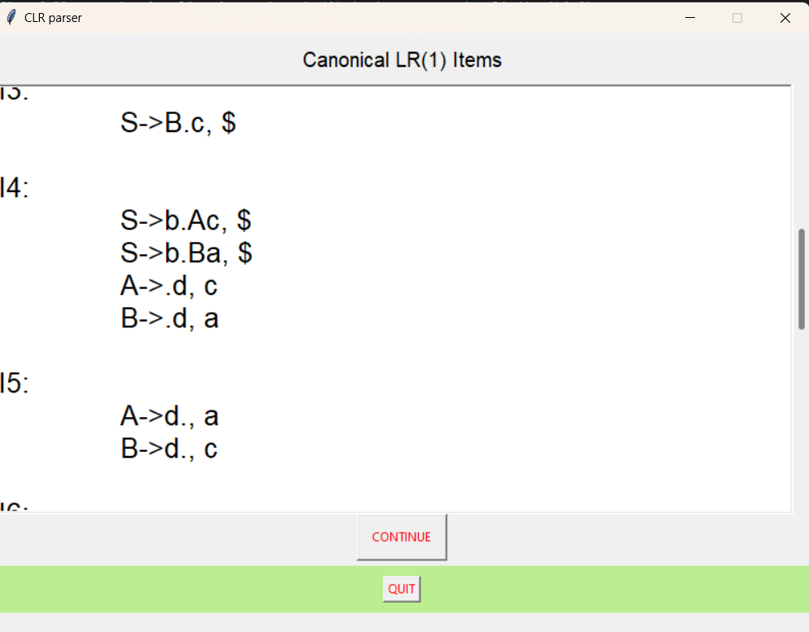
CLR(1) ITEMS:

Slide 8
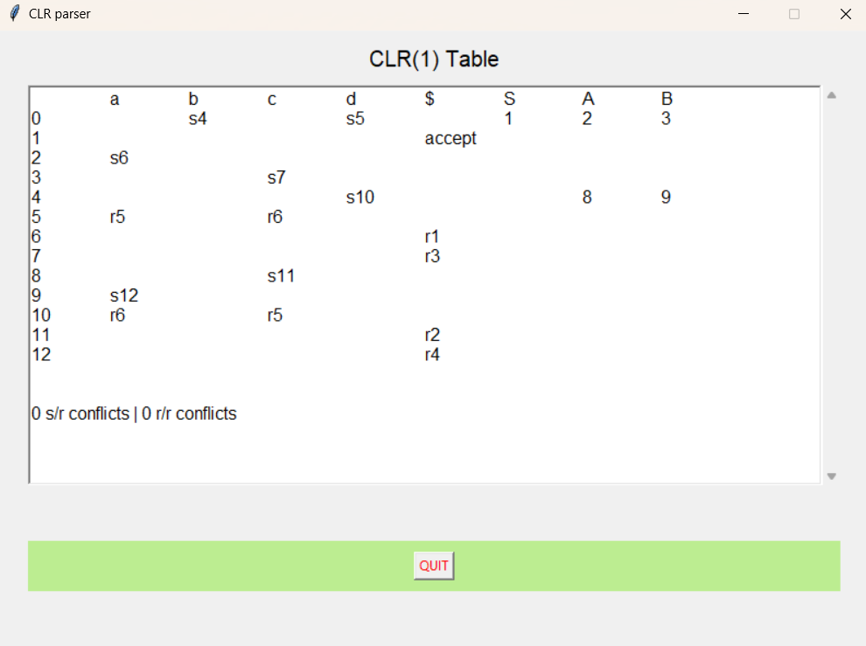
CLR(1) TABLE:

Slide 9
CONCLUSION
In conclusion, the CLR parser is a powerful tool for compiler design that is able to parse complex grammars and generate a parse tree. The syntax analysis project for CLR parser implementation involves several steps such as lexical analysis, tokenization, and syntax analysis. Overall, the CLR parser provides a robust and efficient solution for syntax analysis in compiler design. It is widely used in industry and academia for the implementation of compilers and interpreters for various programming languages.

Slide 10
THANK YOU

